Slide 1
File System Project
By Christian Boni

Slide 2
Test Case 1:
dir \
specialcopy C:\pitt.png \
copy \pitt.png \yyy
mkdir \zzz
copy \yyy \zzz
dir \zzz
del \pitt.png
copy \zzz\yyy \aaa
dir \

Slide 3
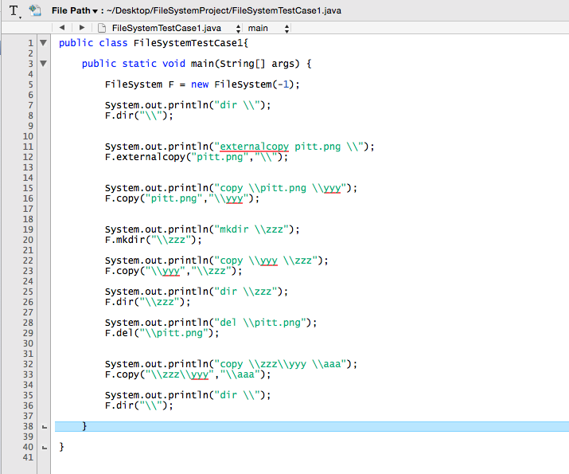
Code for the Driver:

Slide 4
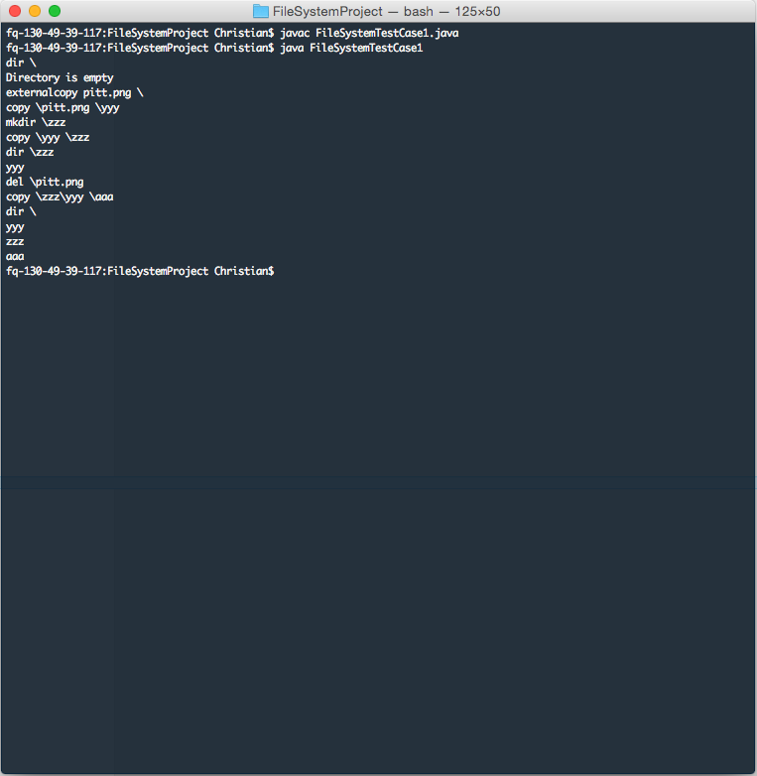
Terminal Results:

Slide 5
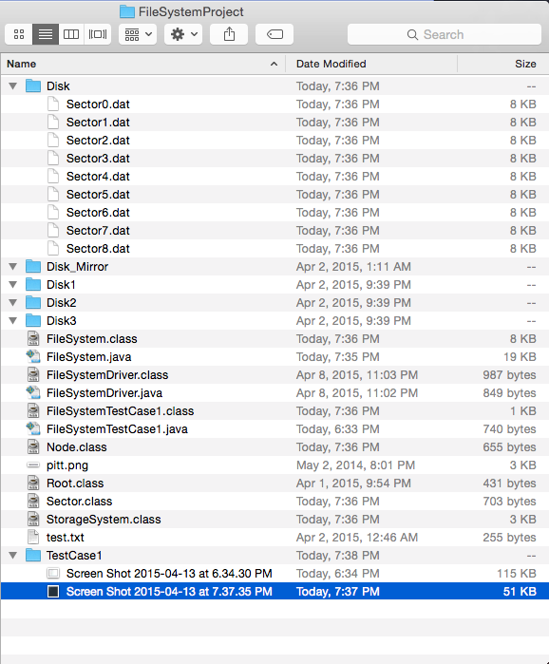
Resulting Storage System
Contents of each Sector can be viewed in FileSystemProject/TestCase1_Results/Disk
As you can see there are 9 sectors corresponding to the root, its directories and its files:
Root – 1 Sector
Pitt.png – 3 Sectors
Yyy – 3 Sectors
Zzz – 1 Sector
Aaa – 1 Sector

Slide 6
Test Case 2 – Raid 1:
dir \
specialcopy C:\pitt.png \
dir \

Slide 7
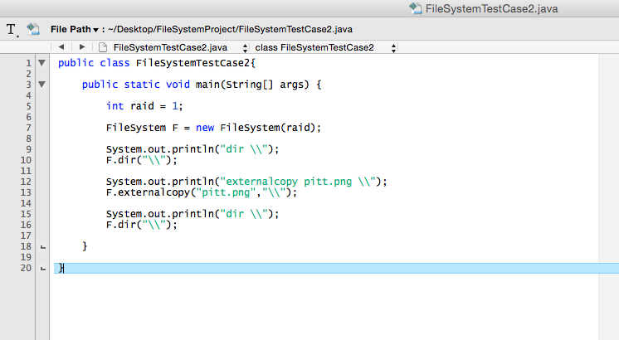
Code for the Driver:

Slide 8
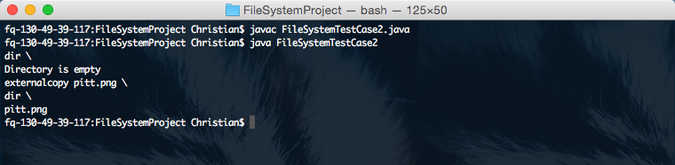
Terminal Results:

Slide 9
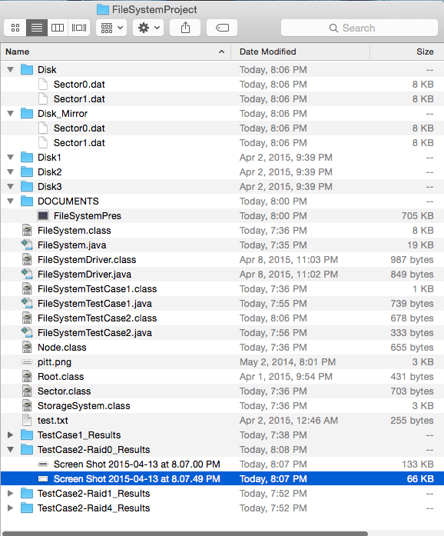
Resulting Storage System
Contents of each Sector can be viewed in:
TestCase2-Raid1_Results/Disk TestCase2-Raid1_Results/Disk_Mirror
As you can see there are 2 sectors per disk corresponding to the root and the pitt.png file.
Root – 1 Sector (each disk)
Pitt.png – 1 Sector (each disk)

Slide 10
Test Case 2 – Raid 0:
dir \
specialcopy C:\pitt.png \
dir \

Slide 11
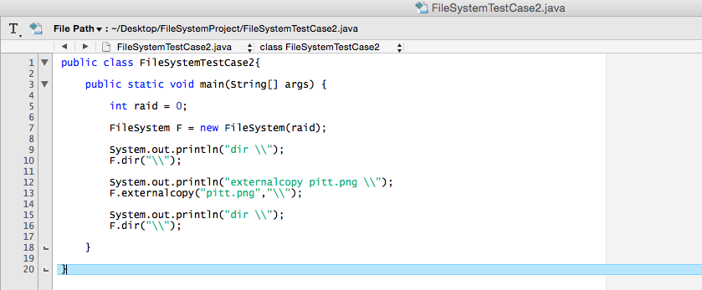
Code for the Driver:

Slide 12
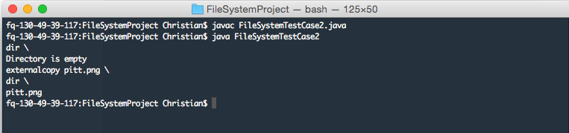
Terminal Results:

Slide 13
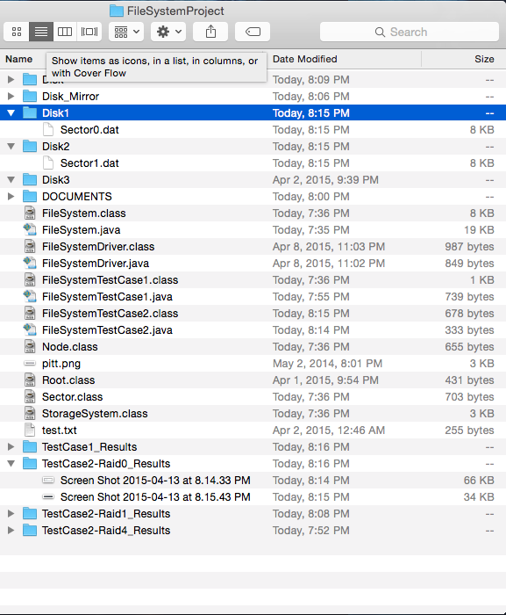
Resulting Storage System
Contents of each Sector can be viewed in :
TestCase2-Raid0_Results/Disk1 TestCase2-Raid0_Results/Disk2 TestCase2-Raid0_Results/Disk3
As you can see there are 2 sectors stored corresponding to the root and the pitt.png file.
Root – 1 Sector (in disk 1)
Pitt.png – 1 Sector (in disk 2)

Slide 14
Test Case 2 – Raid 4:
dir \
specialcopy C:\pitt.png \
dir \

Slide 15
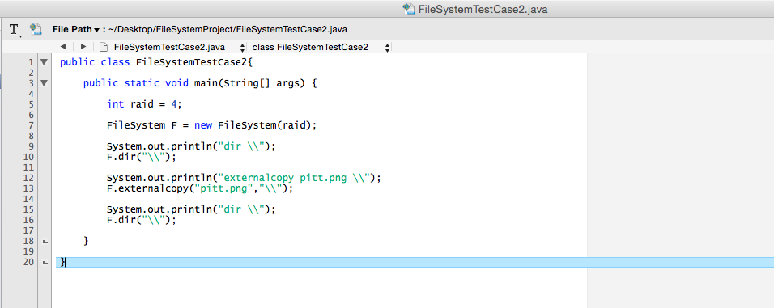
Code for the Driver:

Slide 16
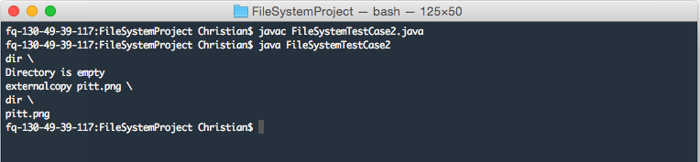
Terminal Results:

Slide 17
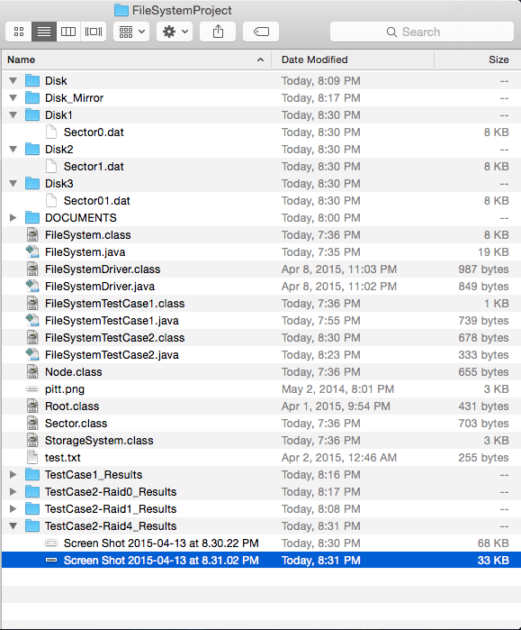
Resulting Storage System
Contents of each Sector can be viewed in :
TestCase2-Raid4_Results/Disk1 TestCase2-Raid4_Results/Disk2 TestCase2-Raid4_Results/Disk3
As you can see there are 2 sectors stored corresponding to the root and the pitt.png file and 1 sector corresponding to the parity sector.
Root – 1 Sector (in disk 1)
Pitt.png – 1 Sector (in disk 2)
Parity Sector – 1 Sector (in disk 3)

Slide 18
Test Case 2 – Raid 5:
dir \
specialcopy C:\pitt.png \
dir \

Slide 19
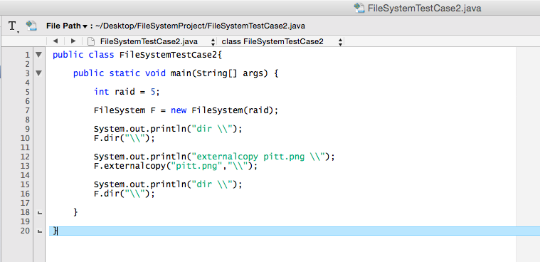
Code for the Driver:

Slide 20
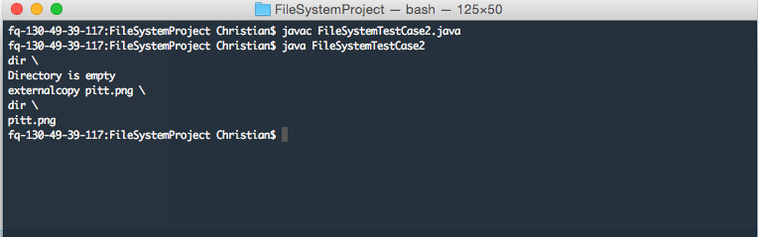
Terminal Results:

Slide 21
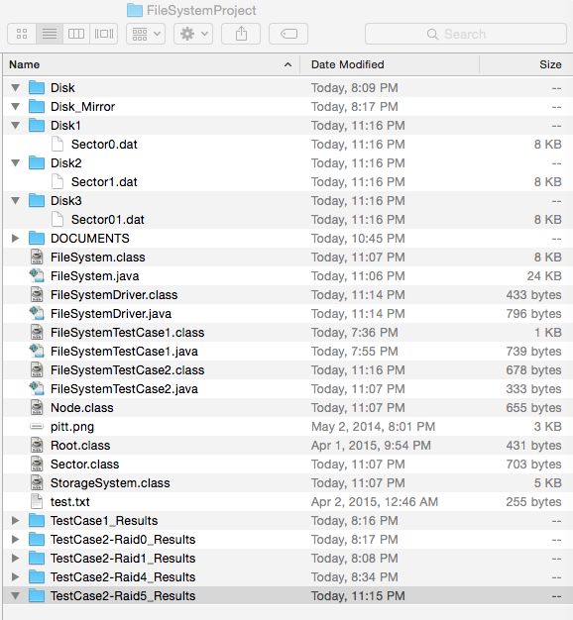
Resulting Storage System
Contents of each Sector can be viewed in :
TestCase2-Raid5_Results/Disk1 TestCase2-Raid5_Results/Disk2 TestCase2-Raid5_Results/Disk3
As you can see there are 2 sectors stored corresponding to the root and the pitt.png file and 1 sector corresponding to the parity sector.
Root – 1 Sector (in disk 1)
Pitt.png – 1 Sector (in disk 2)
Parity Sector – 1 Sector (in disk 3)

